Slide 1
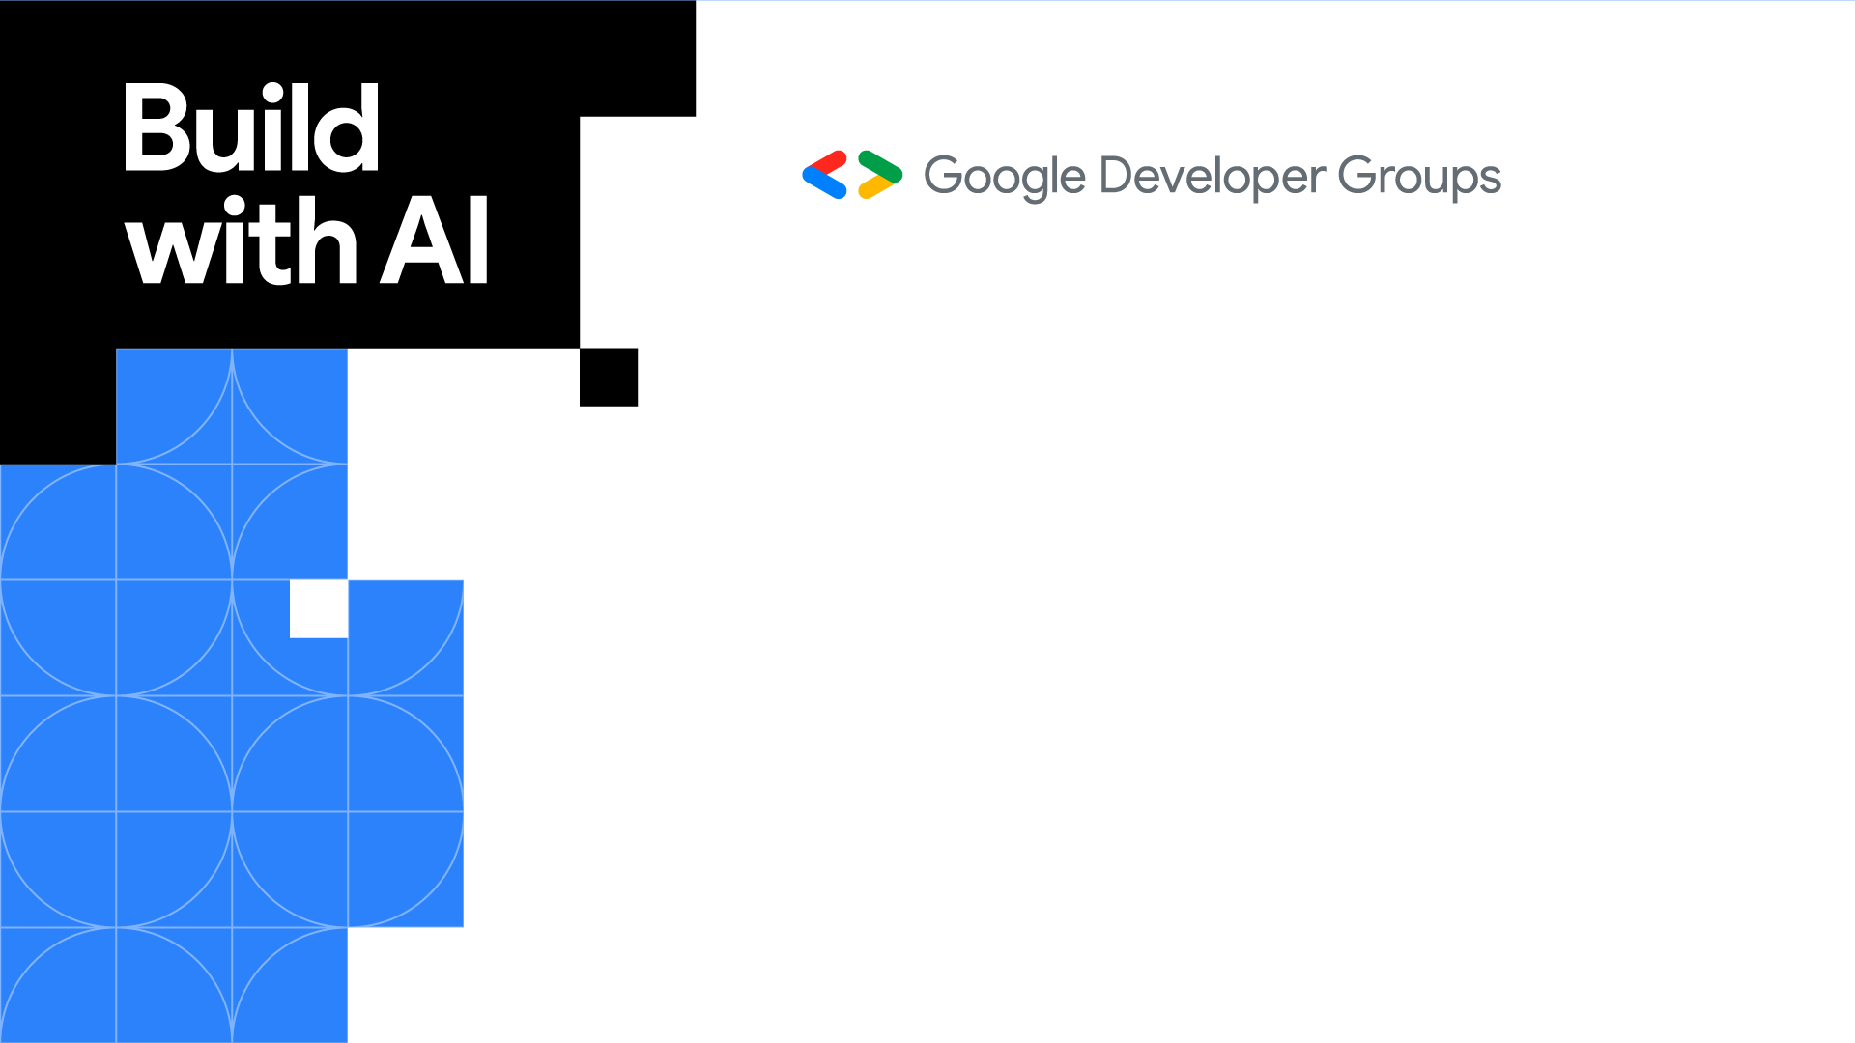
GENERATIVE AI
Editable Location

Slide 2


JONATHAN NDAMBUKI
Training Manager
Teach2Give, Nyeri
Editable Location

Slide 3
PART 1: GENERAL VIEW

Slide 4
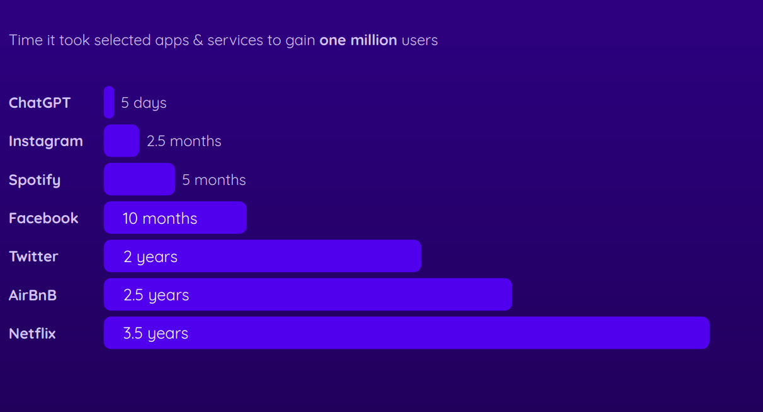
The Fastest Growing App

Slide 5
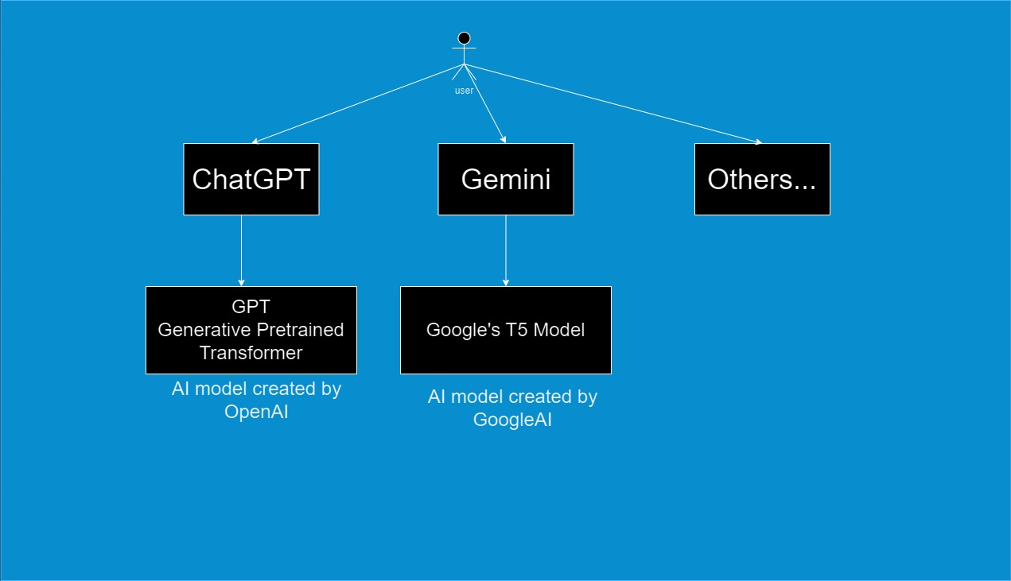
Understanding A Large Language Model. GPT and Google T5 are LLM’s But what is a Large Language Model?

Slide 6
What is a Large Language Model
A large language model is an AI-powered system based on neural network of transformer trained on vast amounts of text data to generate human like text output by predicting the next word based on the user input prompt.
A machine learning model that performs Natural Language Processing (NLP) tasks
Trained to use probability distributions over words & sequences of words to generate output.

Slide 7
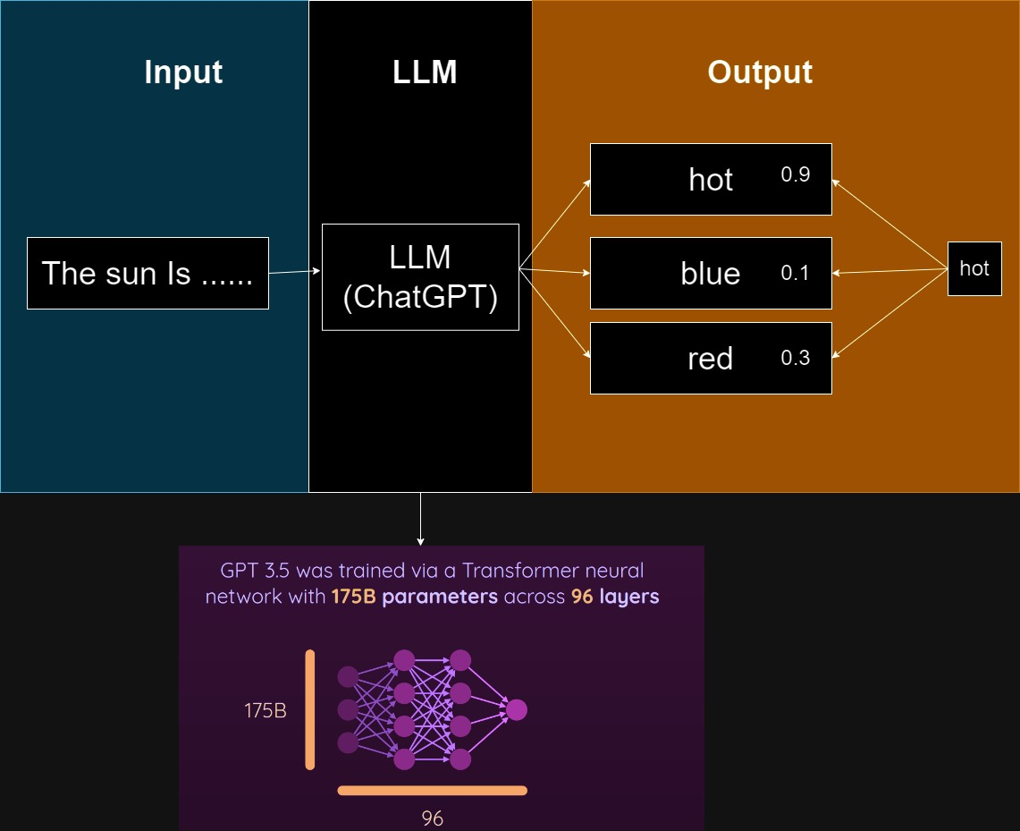
LLM in simple words
Large language models just complete sequences but in an adaptive, informative and responsive way.

Slide 8
Training Data
Most model are trained with all publicly available text data from the internet

Slide 9
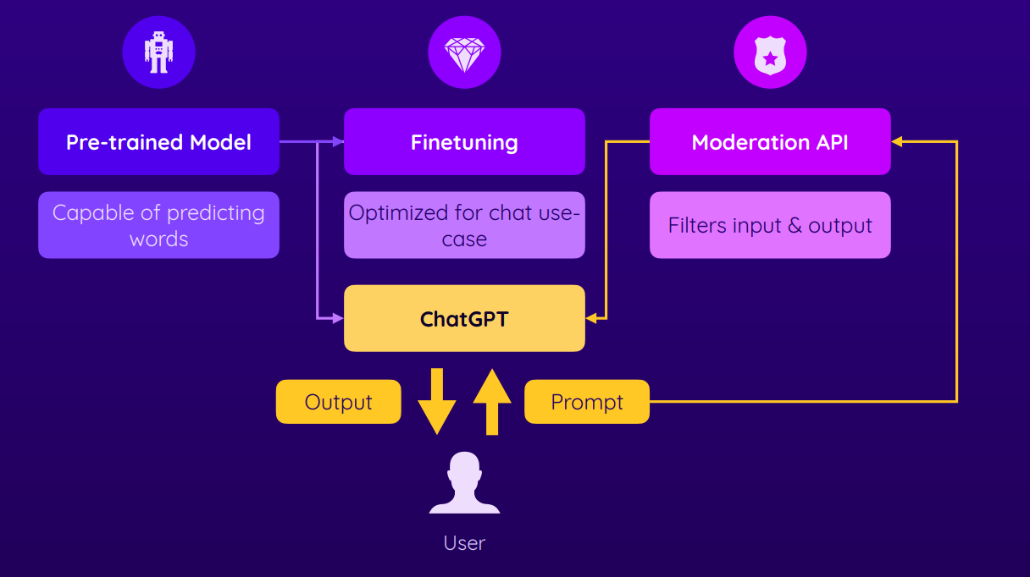
Fine-tuning & Moderation

Slide 10
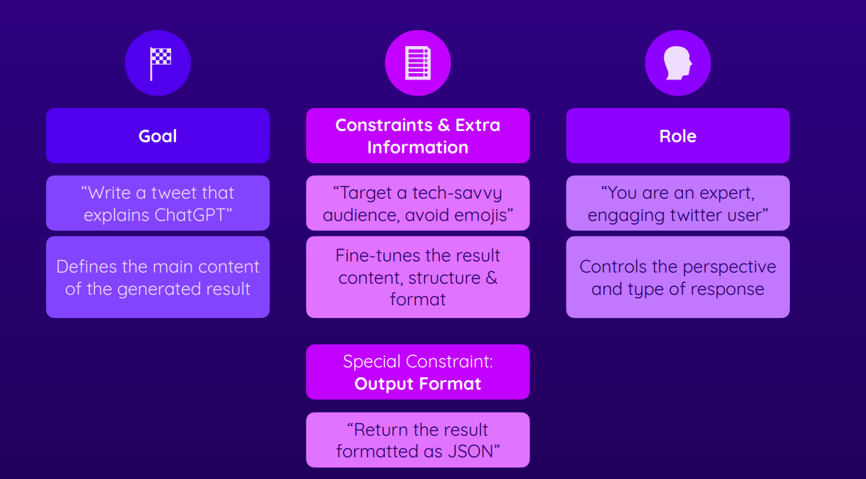
Prompt Engineering
Why Prompt Engineering
Good prompts = Good results

Slide 11
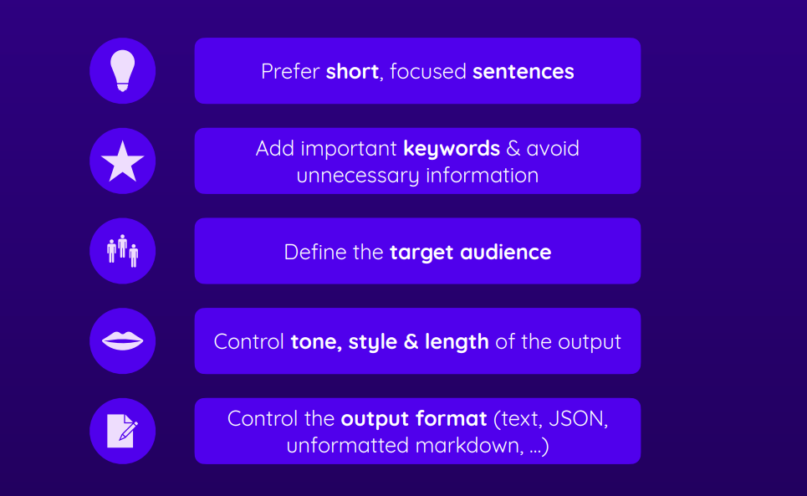
Adding Meaningful Context

Slide 12
DEMO

Slide 13
PART 2 DEVELOPER VIEW

Slide 14
What is Application Programming Interface(API)
Communication between two applications using requests and Responses

Slide 15
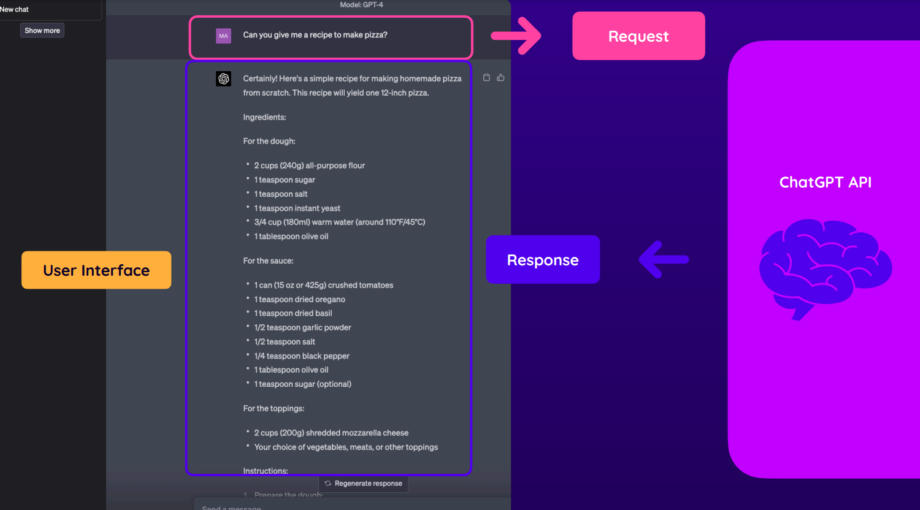
GPT APIS

Slide 16
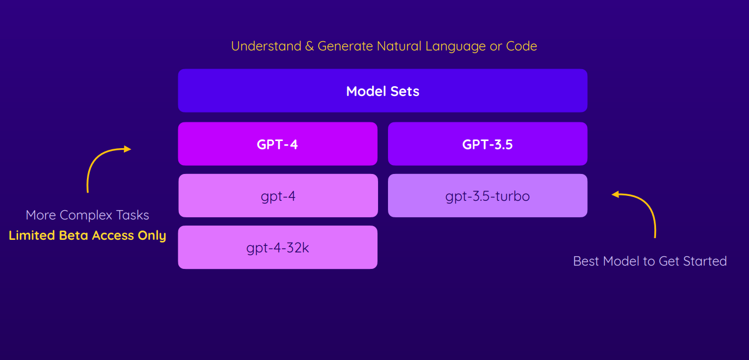
Recommended GPT API Models

Slide 17
But..
Using the APIs incurs some cost depending on the Tokens used.
1 Token = 0.75 words = 4 characters

Slide 18
DEMO

Slide 19
PART 3 INNOVATOR VIEW

Slide 20
Limitation of most LLM’s
Limited training data
It’s not about patterns not logic
It can only handle and output text as input and output

Slide 21

Solution : Build your Own LLM

Slide 22
DEMO

Slide 23
Limitation of most LLM’s
Limited training data
It’s not about patterns not logic
It can only handle and output text as input and output

Slide 24
My Two Cents about the Future of AI
Expect the following in future and coming years
Mobile AI
More LLM
Multi-Modal LLM
But keep in mind about ethical considerations as you build

Slide 25
THE END

